Slide 1

Lesson 5 PYRAMIDS AND CONES Solids for which V=1/3 Bh
Week 7
Math 13
Solid Mensuration
Notes:
Week 5

Slide 2
PYRAMID
A pyramid is a polyhedron containing triangular lateral faces with a common vertex and a base which is a polygon.
A pyramid is a right pyramid if the line joining the vertex and the center of base is perpendicular to the plane of the base. Otherwise, the pyramid is said to be oblique.
If the base of a right pyramid is a regular polygon then the solid is said to be a regular pyramid.

Slide 3
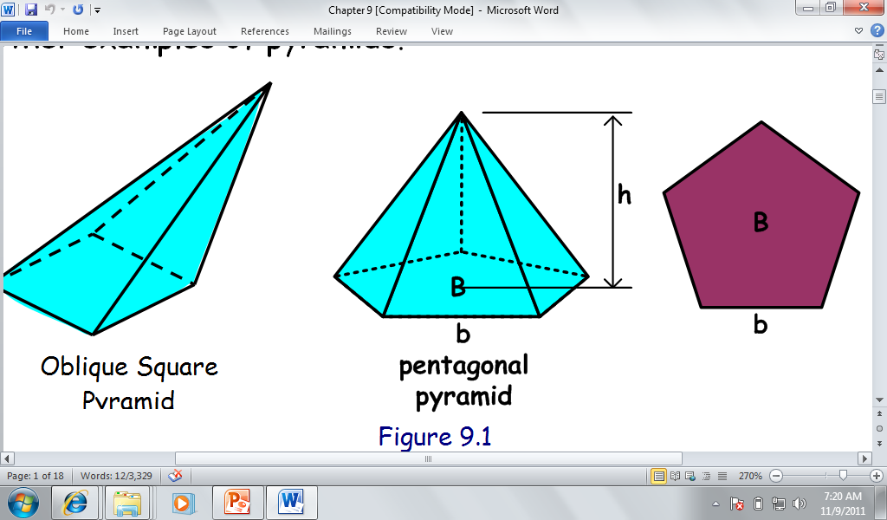
A pyramid is named by the type of polygon in its base.

Slide 4
The lateral surface area of a regular pyramid is equal to half the product of the perimeter of its base and its slant height.
TOTAL SURFACE AREA:

Slide 5
Volume of Pyramid
Where B=base area (polygon)

Slide 6
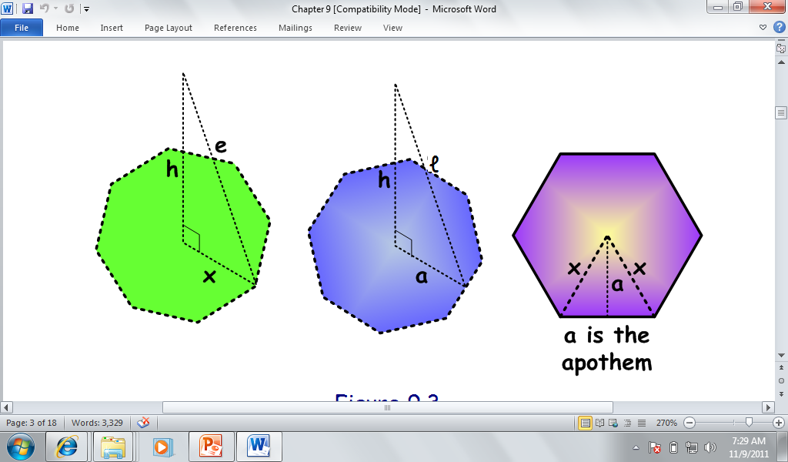
Relationships Among Altitude, Slant Height, Lateral Edge and the Base

Slide 7
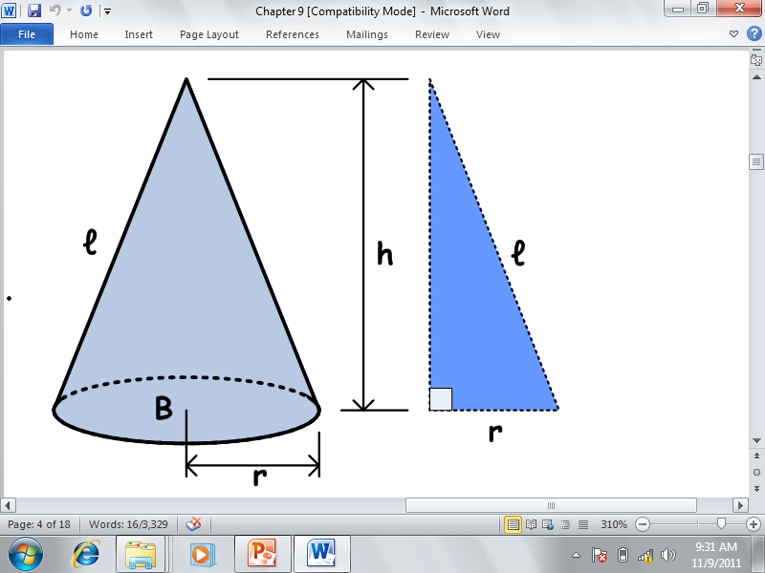
CONES
A circular cone is a cone whose base is
a circle.
The axis of a circular cone
is the line segment joining the
apex and the center of the base.
If the axis is perpendicular to
the base, the cone is a
right circular cone .

Slide 8
A cone whose axis is not perpendicular to the base is called oblique.
Unless otherwise specified, a cone generally has a circular base.

Slide 9
Surface Area of Cone
Lateral Area :
Total Surface Area:

Slide 10
Volume of Cone

Slide 11
EXAMPLE: A regular hexagonal pyramid has one lateral edge which measures 10 cm. The length of one side of its base is 6 cm. Find the altitude and the slant height of the given pyramid. Also find the volume and the total surface area.
ANS: l=9.54 cm, h=8 cm, V=249.6 cu.cm.
LSA= 265.3 sq.cm.

Slide 12
EXAMPLE: An inverted square pyramid has a height equal to 8m and a top edge equal to 3m. Initially, it contains water to a depth of 5m.
What is the initial volume of the water in the tank?
If additional water is to be pumped into the tank at the rate of 20 gallons per minute, how many hours will it take to fill the tank?
ANS: 5.86 cu.m, 4hrs

Slide 13
EXAMPLE: A right circular cone has a lateral area of
ft² and a base area of 512π ft². Find the volume.
EXAMPLE: Water is flowing out of a conical funnel through its apex at a rate of 12 cubic inches per minute. If the funnel is initially full, how long will it take for it to be one-third-full? What is the height of the water level? Assume the radius to be 6 inches and the altitude of the cone to be 15 inches.

Slide 14
Homework
Exercise 5.1 pp. 131-132
#’s 1-b, 1-c, 7, 17
Exercise 5.2 pp. 139-141
#’s 1, 3, 23

